Slide 1
Get Started with Career Ahead
Slide Pack for Lecturers
Created by the Careers and Employability Service

Slide 2
Use this slide pack to:
Inform students about the Career Ahead Employability Award.​
Discuss the different activities within Career Ahead.​
Explain the Career Ahead points system.​
Demonstrate how to access and start the Career Ahead award.​
Further information on the award is on My Cumbria https://my.cumbria.ac.uk/Student-Life/careers/Career-Ahead/
​

Slide 3
Career Ahead Award
Your Career Ahead journey will enable you to undertake various activities to achieve Bronze, Silver and Gold levels and could involve:​
Attending employability workshops.*​
Completing short online courses in LinkedIn Learning.​
Attending careers events, appointments or mock interviews.​
Submitting a CV or application form.​
Completing 100 hours of extra-curricular activity.​
Completing a Pathways mini course to boost your knowledge and skills
* Workshops run as part of your course, or book specific workshops on My Career Enriched.

Slide 4
Go to your student hub. Click on the My Career Enriched tile and activate your account

Slide 5
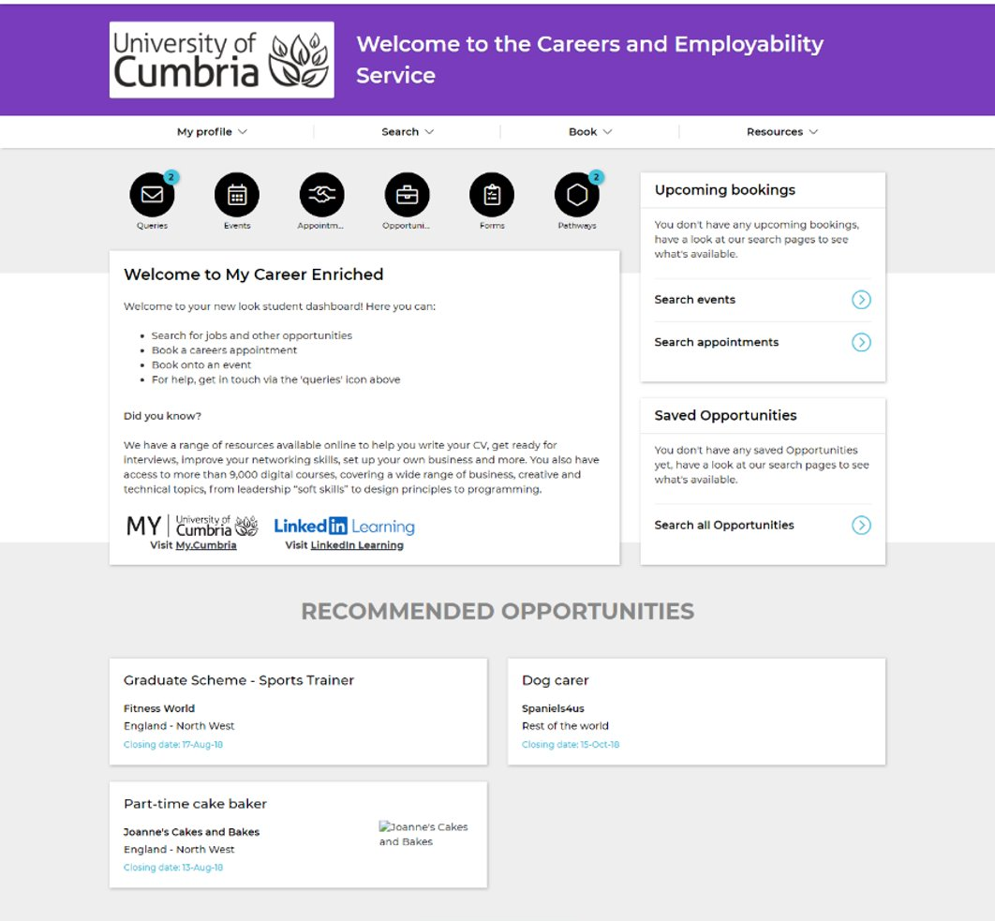
Go to your student hub. Click on the My Career Enriched tile and activate your account.
Click on “Pathways” icon on the dashboard and search for Career Ahead Award OR
Select Career Ahead Employability Award graphic after logging in

Slide 7
What activities can I do?
Career Ahead gives you a choice of activities to complete – you choose how you want to gather points to reach each level. You can choose from the following activities to be awarded the points shown:
Attend a careers interview appointment 100 points
Attend a mock interview appointment 100 points
Upload evidence of 100 hours of work experience 100 points
Upload a CV/application for feedback 100 points

Slide 8
What activities can I do?
Attend a careers event 50 points
Attend a workshop 50 points
Complete a Linked-In Learning course* 50 points
Complete a My Career Enriched Pathways mini course* 50 points
Complete Union Black free online anti-racism course* 50 points
*Please note that although you can attend as many workshops as you like, a maximum of 3 workshops and 3 online training modules count towards Career Ahead. All other careers activities are counted only once.

Slide 9
Workshops Available
CV writing Finding a placement
Applications and supporting statements Finding part time work/volunteering
Developing your LinkedIn profile Networking and speculative applications
Interview skills Graduate schemes and internships
Career planning Team working
Presentations for interviews Further study

Slide 10
LinkedIn Learning https://my.cumbria.ac.uk/LiL

Slide 11
My Career Enriched – your careers hub Activate your account to:
Book a careers appointment or practice interview
Search for jobs, graduate schemes, internships, volunteering opportunities
Attend a careers event or workshop
Get CV/application feedback
Complete the Career Ahead Award
Do a Pathways mini course, search the career discovery feed, complete a skills assessment and much more …

Slide 12
Any questions?

